Slide 1
Deendayal Antyodaya Yojana
National Rural Livelihoods Mission
Ministry of Rural Development, Govt of India
SHG Bank Linkage & Interest Subvention

Slide 2
NRLM SHG Bank Linkage Portal https://daynrlmbl.aajeevika.gov.in
Source data:
  From Banks, directly from CBS on monthly basis.
  No manual intervention for data updation.
Protocols:
  This portal is for SHG Bank Linkage programe.
  Can view SHG wise details with login.
  Transaction between bank and SHG after credit linkage.
  Using the data for monitoring of SHG Bank Linkage and to rollout Interest Subvention in cat2 districts

Slide 3
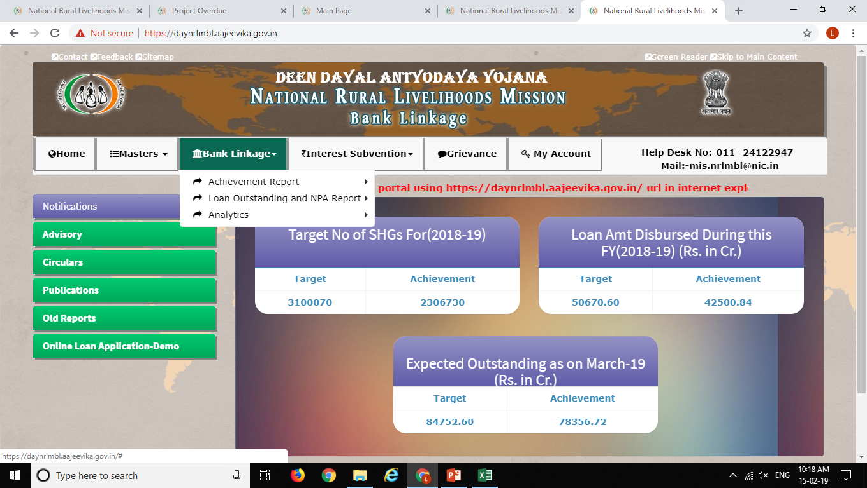

Slide 4
Verification of Geo Masters………..
All the districts are available on the portal or not?
All blocks are available on the portal or not?
All bank branches are available on the portal or not?
Inform NMMU to add missing district, block and branch details
Information required to add Missing Block
Sl.No | Name of the Missing Block | Block code as per MIS Portal | Name of the District

Slide 5
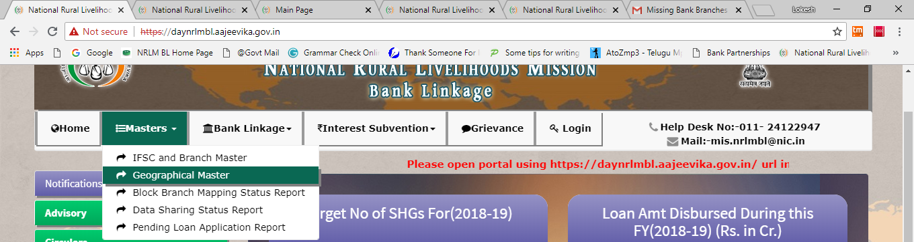
Verification of Geo Masters………..
Information required to add Missing District
Sl.No | Name of the New District | Blocks coming under new district | New Block or Old Block | District name in case of Old Block

Slide 6
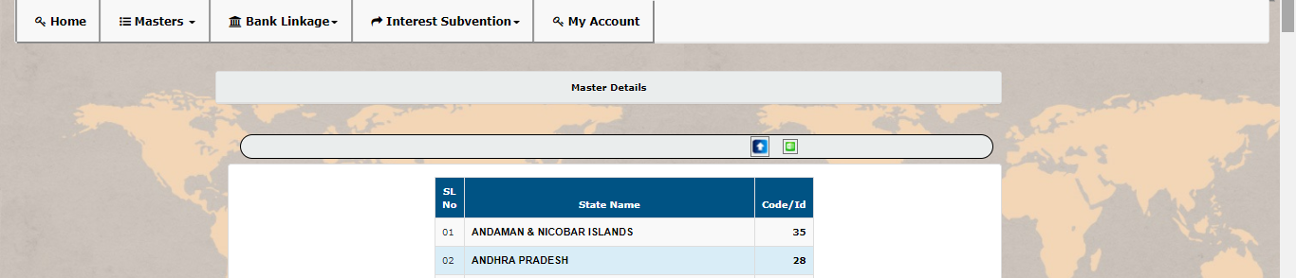
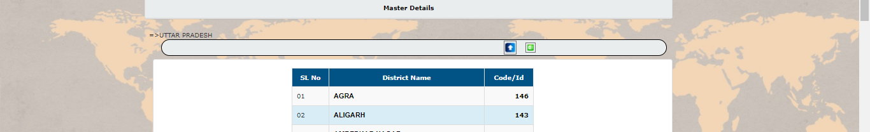
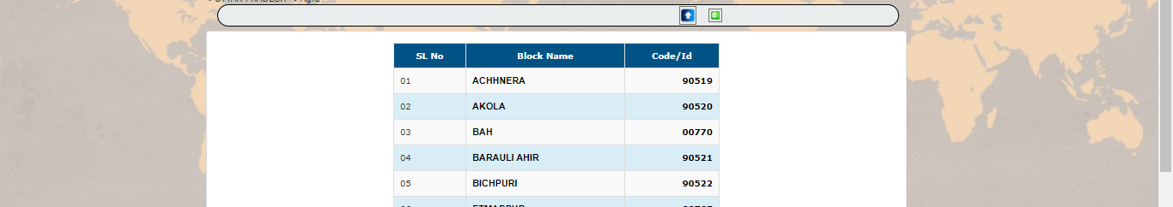

Slide 7

Verification of Bank Branch Masters………..
Whether all the branches available on the portal or not?

Slide 8
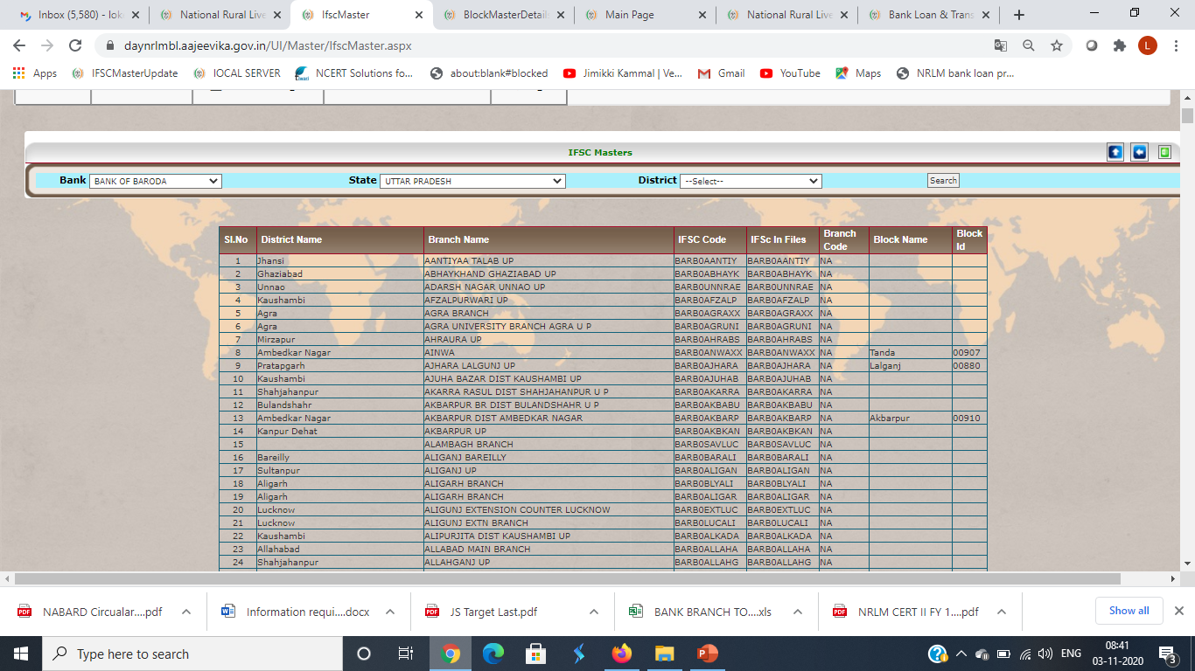
Verification of Bank Branch Masters………..
Whether all the branches available on the portal or not?

Slide 9
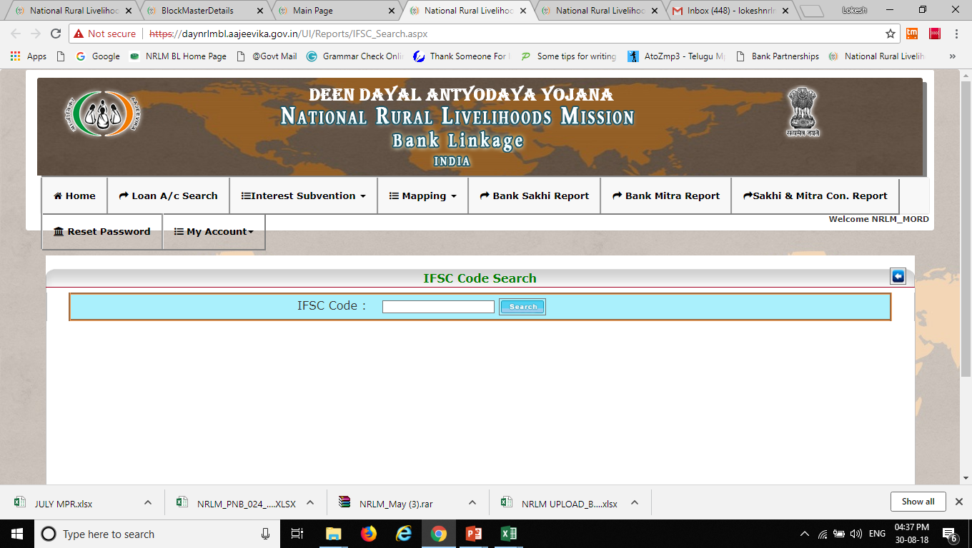
Verification of Bank Branch Masters………..
Whether all the branches available on the portal or not?

Slide 10
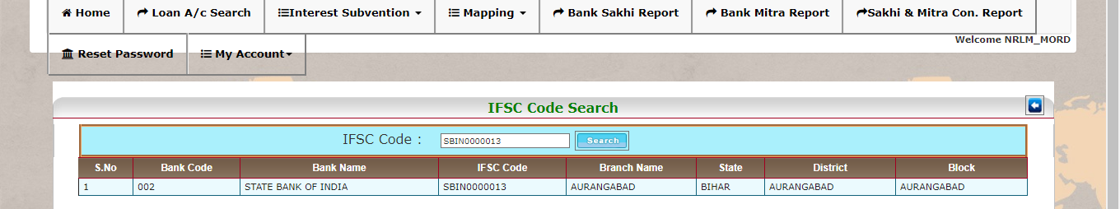
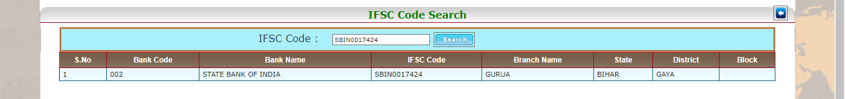
Verification of Bank Branch Masters………..
Information required to add Bank Branch
Sl.No | State | State ID | District | District ID | Block | Block ID | Bank | Branch | IFSC | Branch code (RRBs)

Slide 11
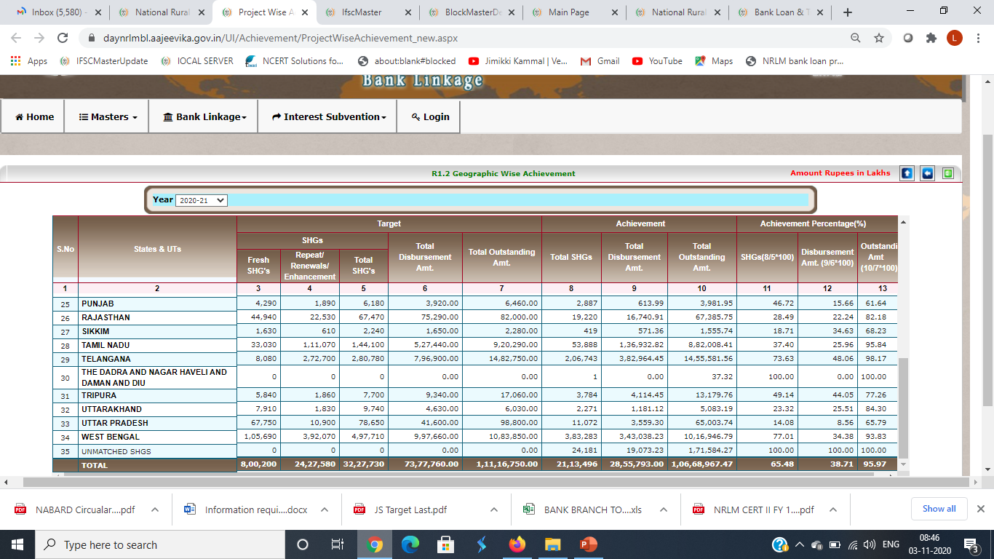
Verification of SHGs and Loans………..
All credit linked SHGs are visible or not?

Slide 12
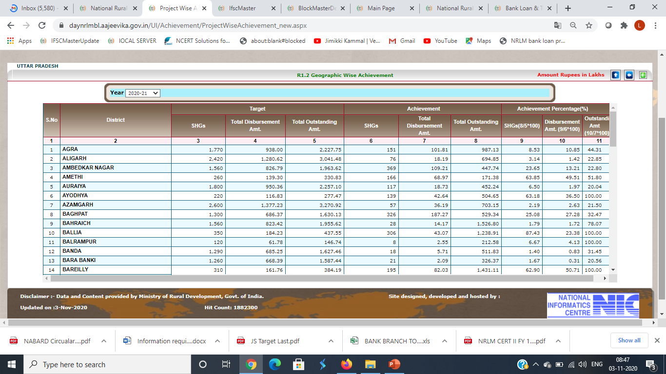
Verification of SHGs and Loans………..
All credit linked SHGs are visible or not?

Slide 13
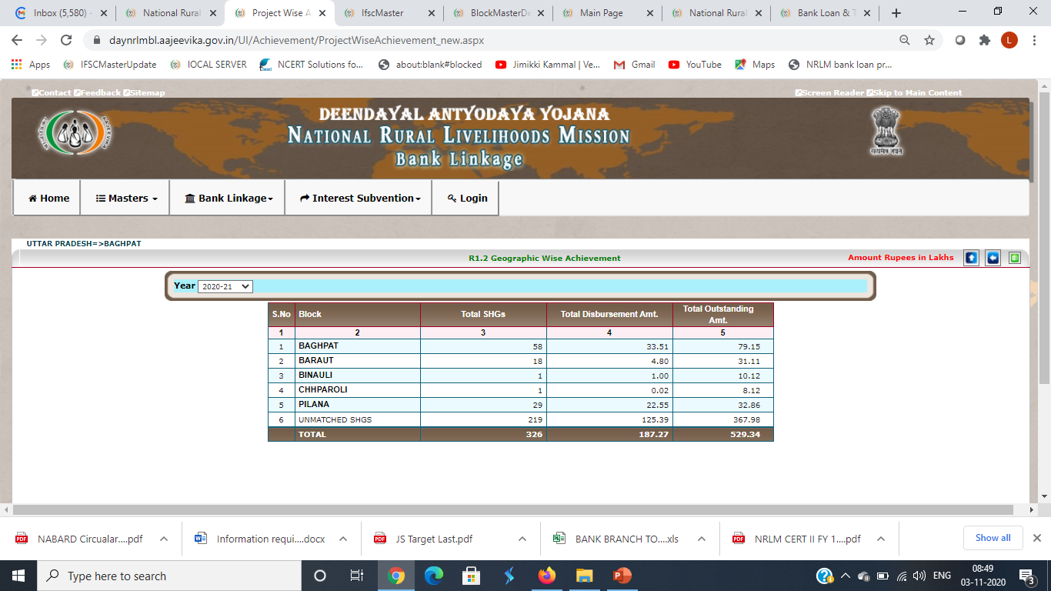
Verification of SHGs and Loans………..
All credit linked SHGs are visible or not?

Slide 14
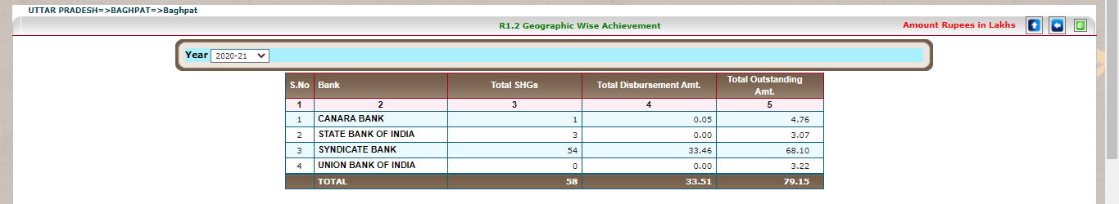
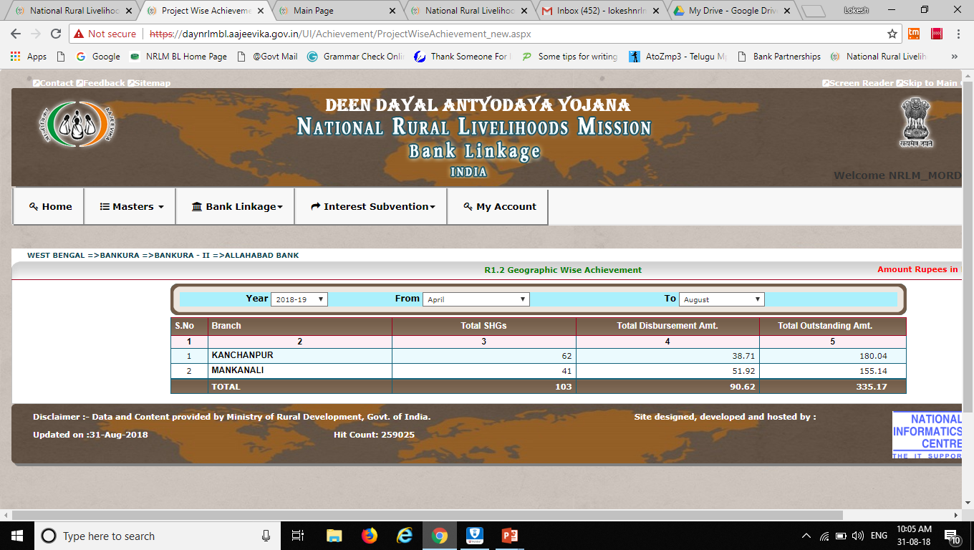
Verification of SHGs and Loans………..
All credit linked SHGs are visible or not?

Slide 15
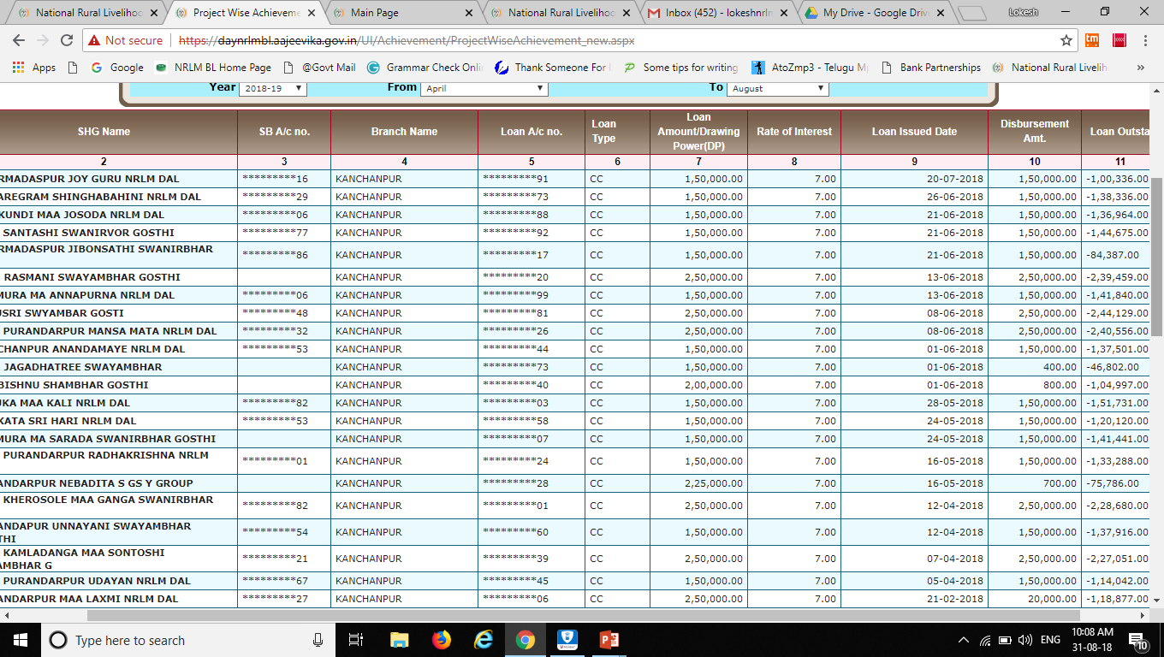
Verification of SHGs and Loans………..
All credit linked SHGs are visible or not?

Slide 16
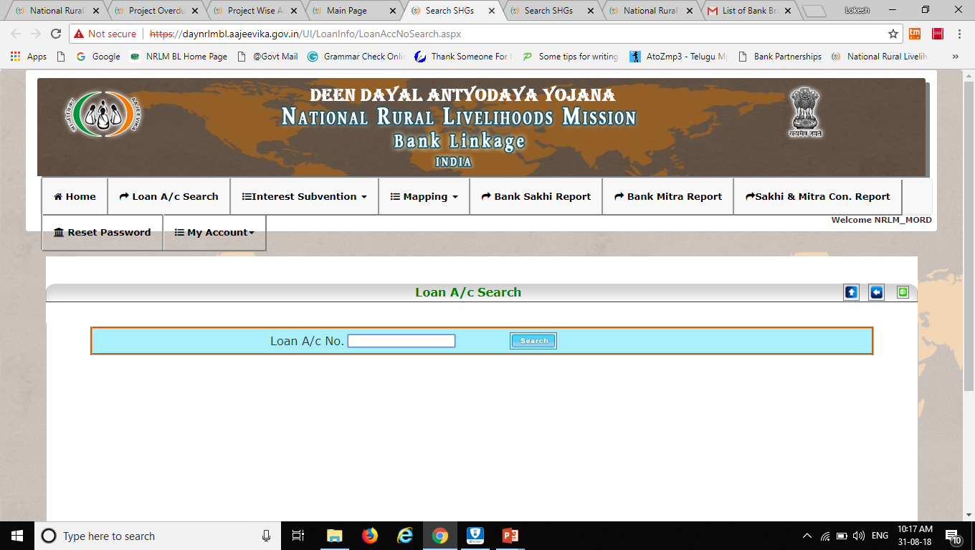
Verification of SHGs and Loans………..
All credit linked SHGs are visible or not?

Slide 17
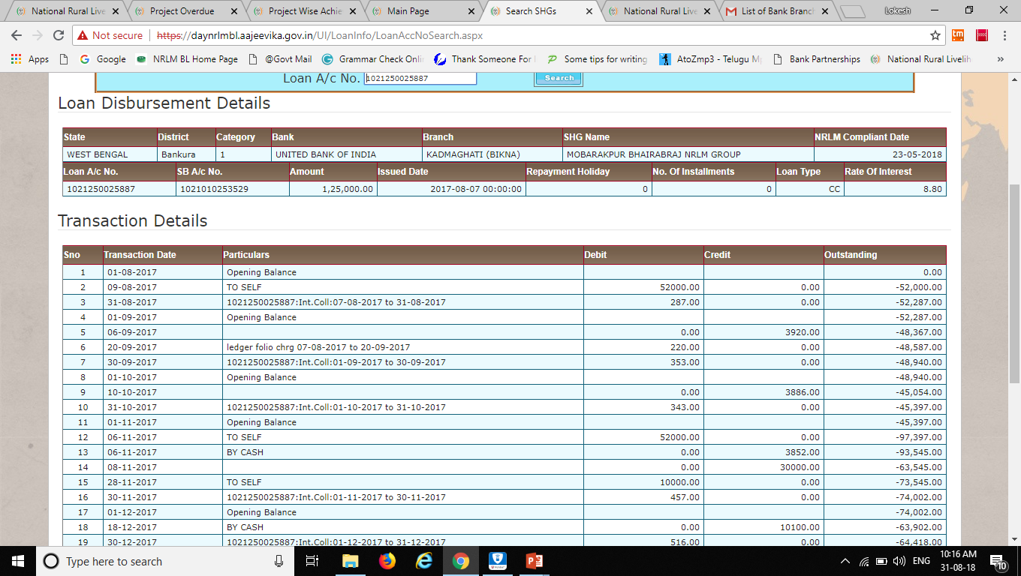
Verification of SHGs and Loans………..
All credit linked SHGs are visible or not?

Slide 18
SHG Bank Linkage – State Login ID

Slide 19
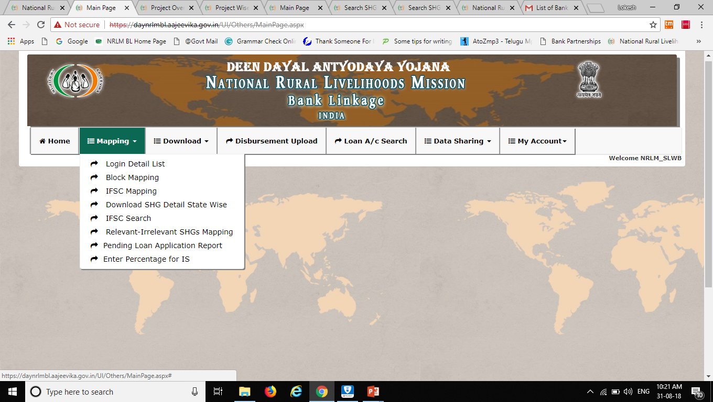
Options available in State Login ID………..

Slide 20
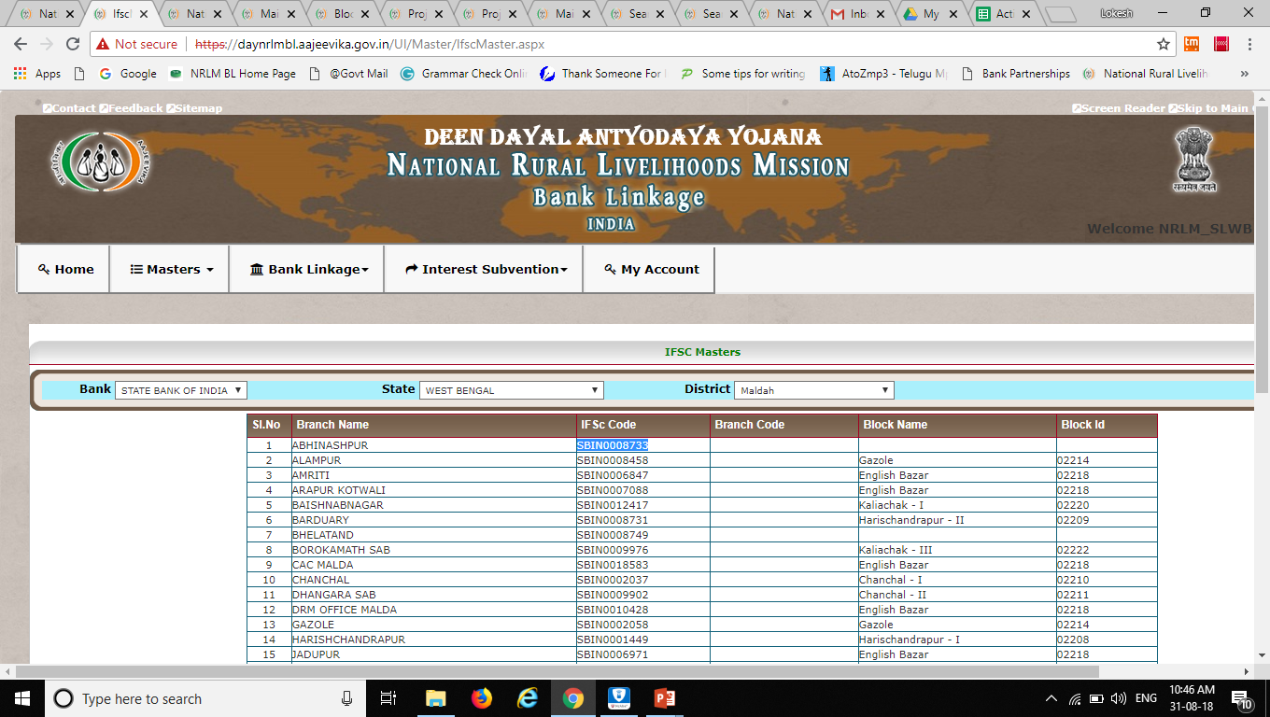
Options available in State Login ID………..

Slide 21
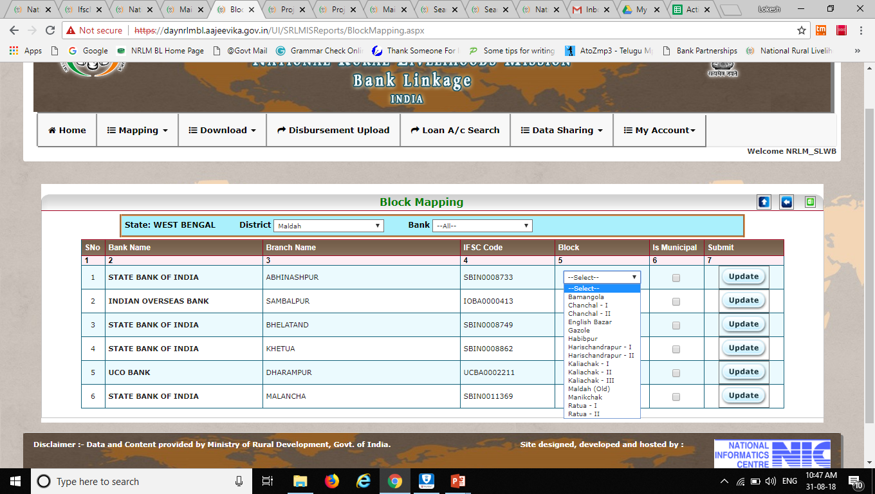
Options available in State Login ID………..

Slide 22
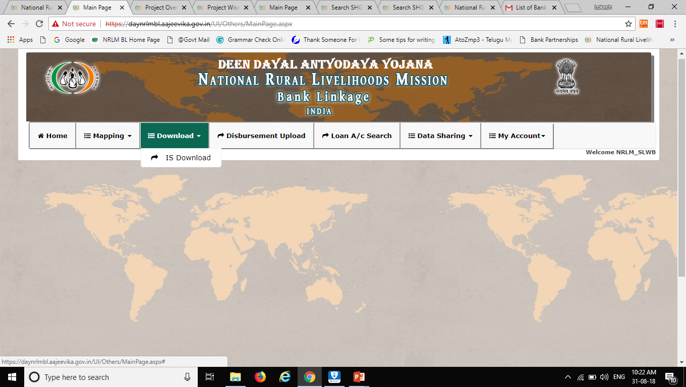
Options available in State Login ID………..

Slide 23
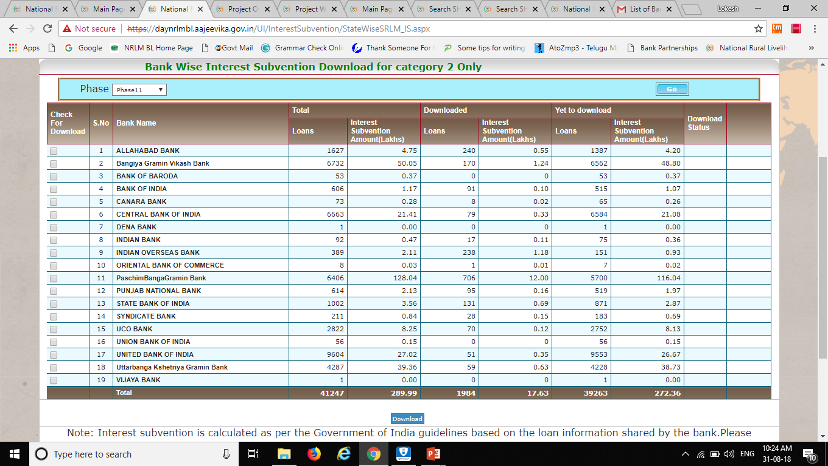
Options available in State Login ID………..

Slide 24
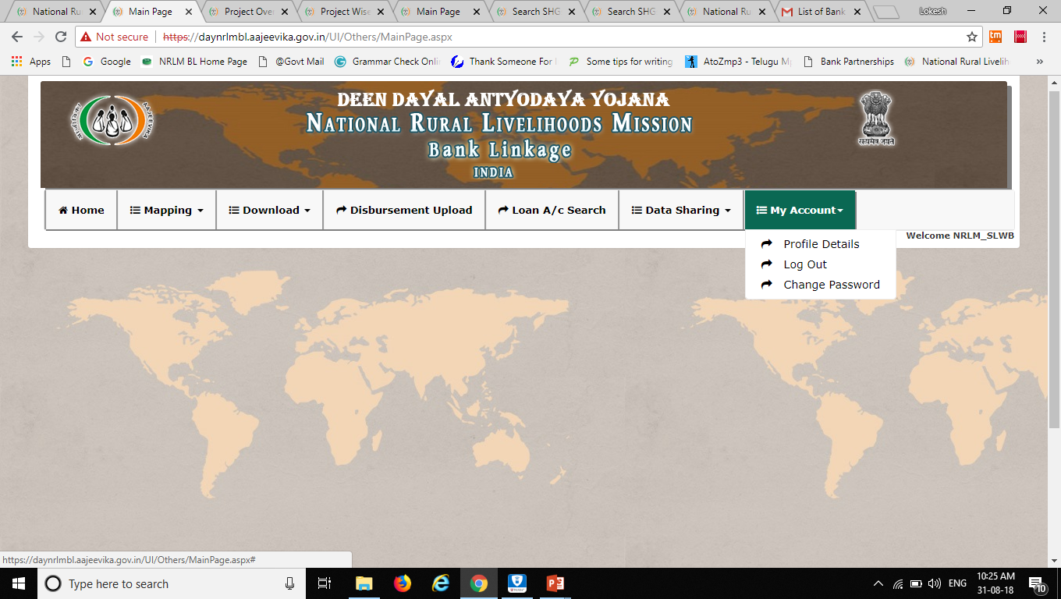
Options available in State Login ID………..

Slide 25
SHG Bank Linkage – District Login ID

Slide 26
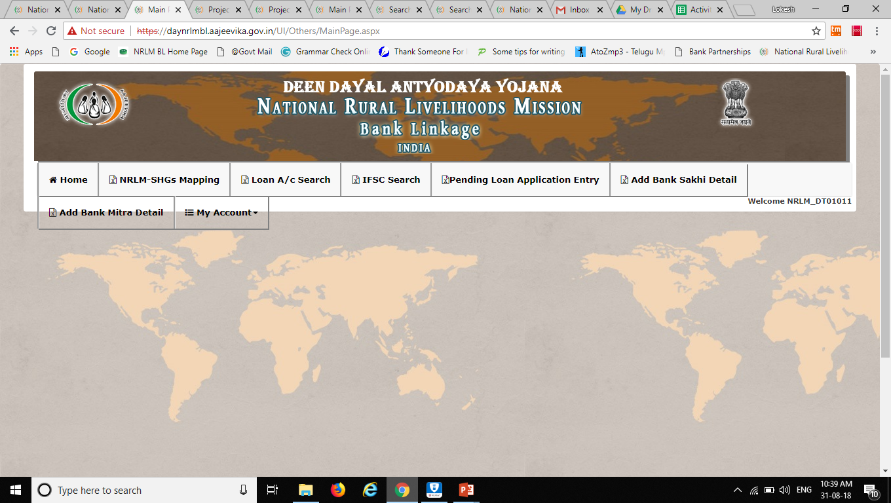
Options available in District Login ID………..

Slide 27
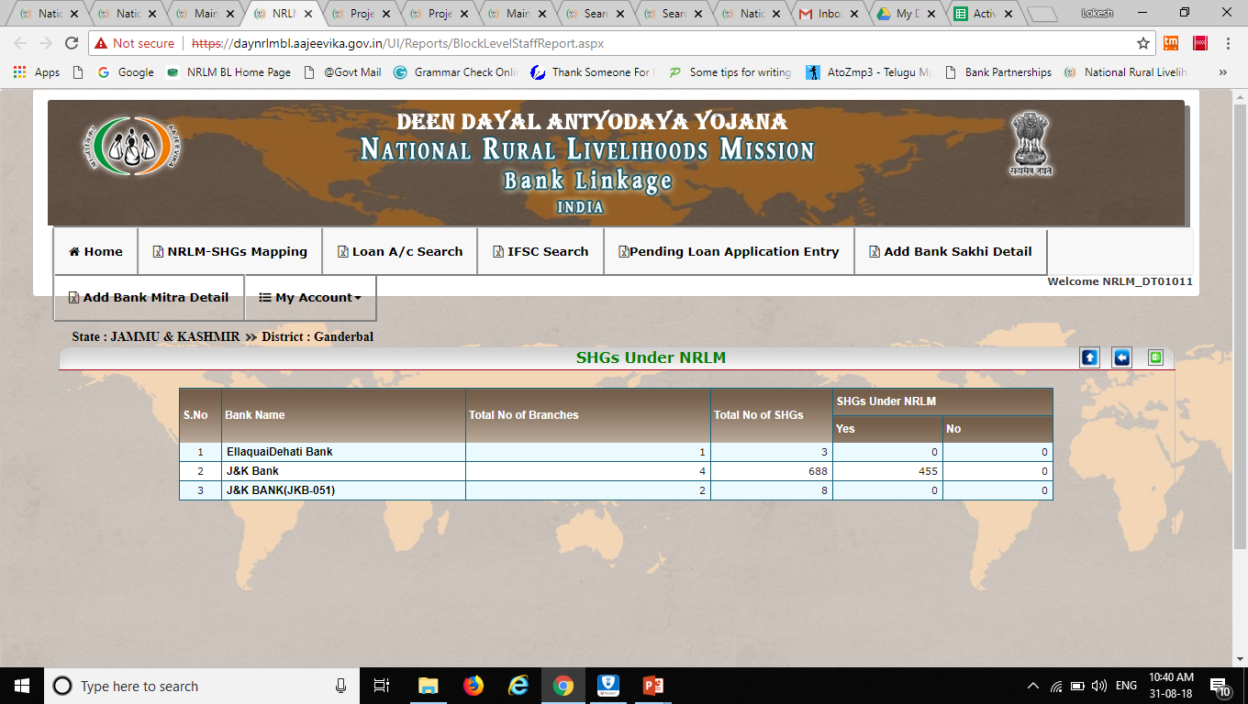
Options available in District Login ID………..

Slide 28
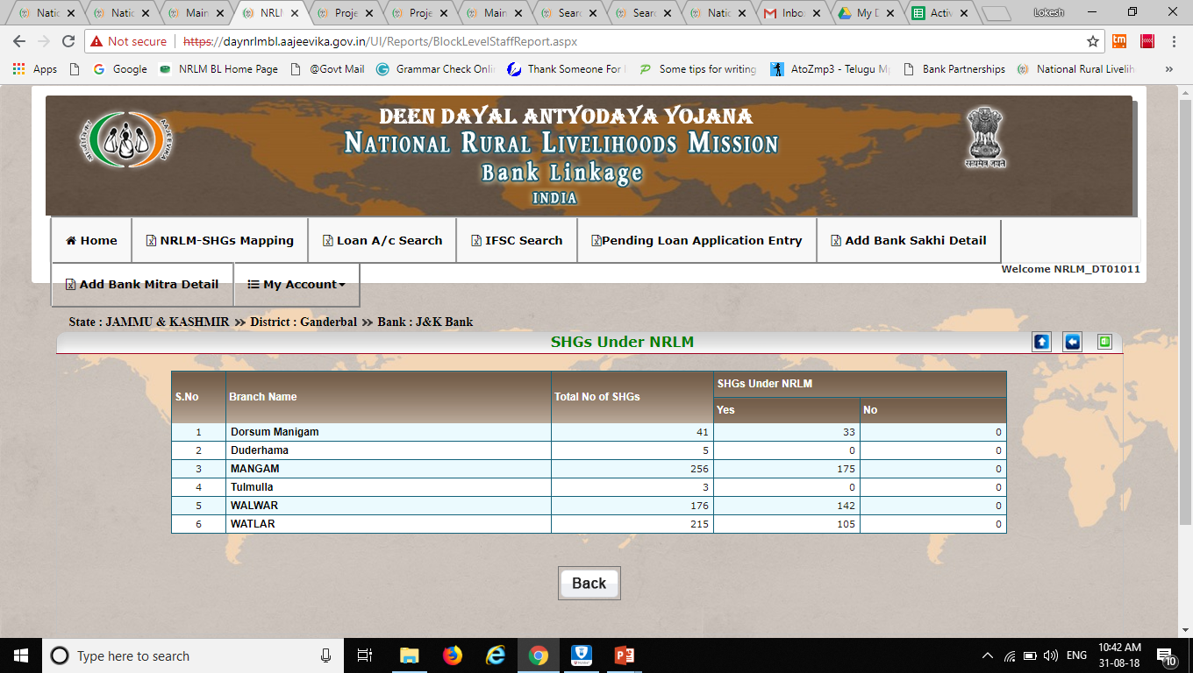
Options available in District Login ID………..

Slide 29
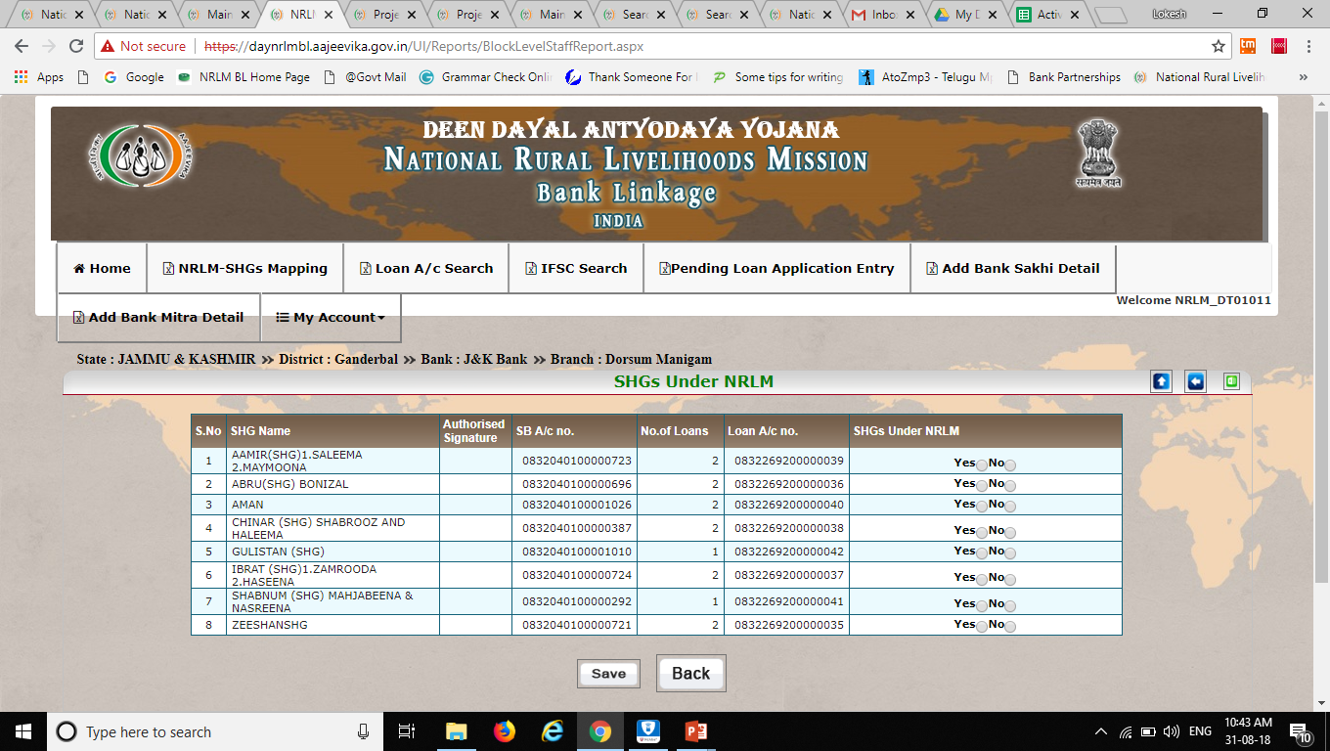
Options available in District Login ID………..

Slide 30

Options available in District Login ID………..

Slide 31
Challenges
Product Codes - ……………..
Monitoring of data sharing by states
Use of reports by Banks and States
Reconsolidation reports: Bank – BL Portal.

Slide 32
Operational Issues
Geo Master issue – Missing Districts and Blocks
Bank Master issue – Missing Bank and Branches
Branch Master issue – Wrongly Mapped Branches
Missing Loan accounts
Non-SHG details
Marking of NRLM SHGs
Disbursement of Interest Subvention in Category 2 districts

Slide 33
Interest Subvention

Slide 34
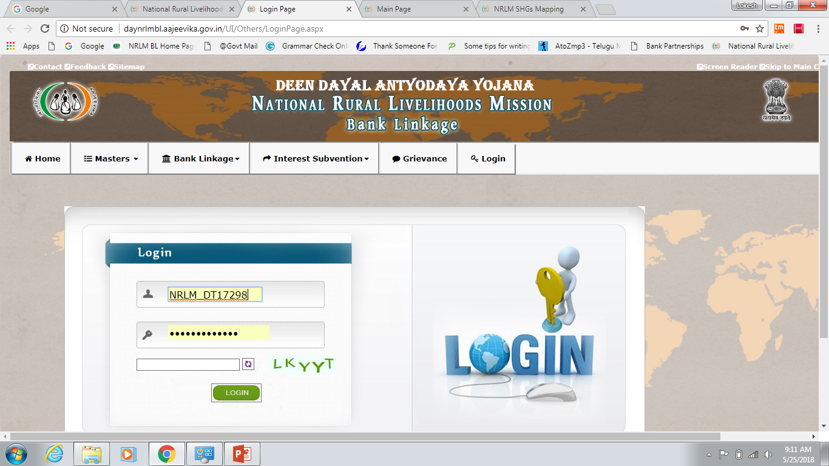

Slide 35
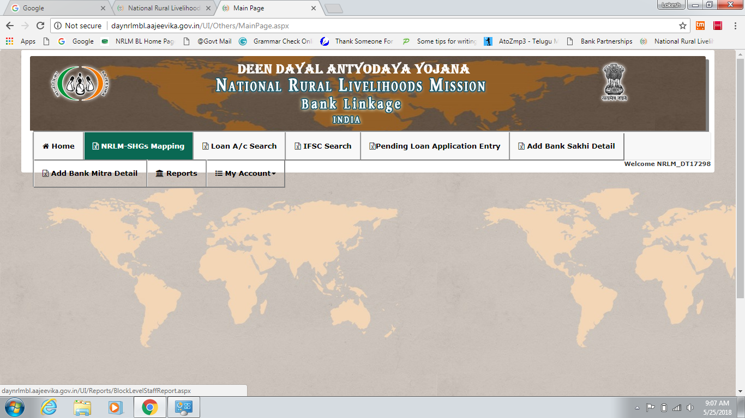

Slide 36
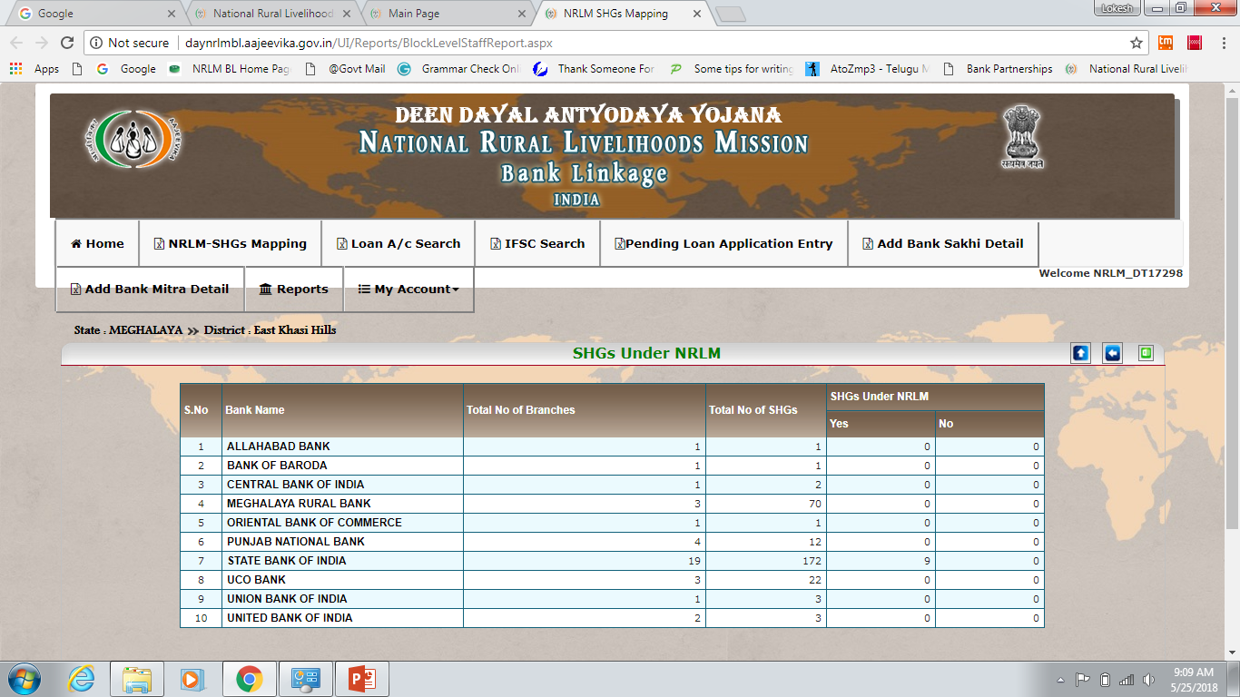

Slide 37
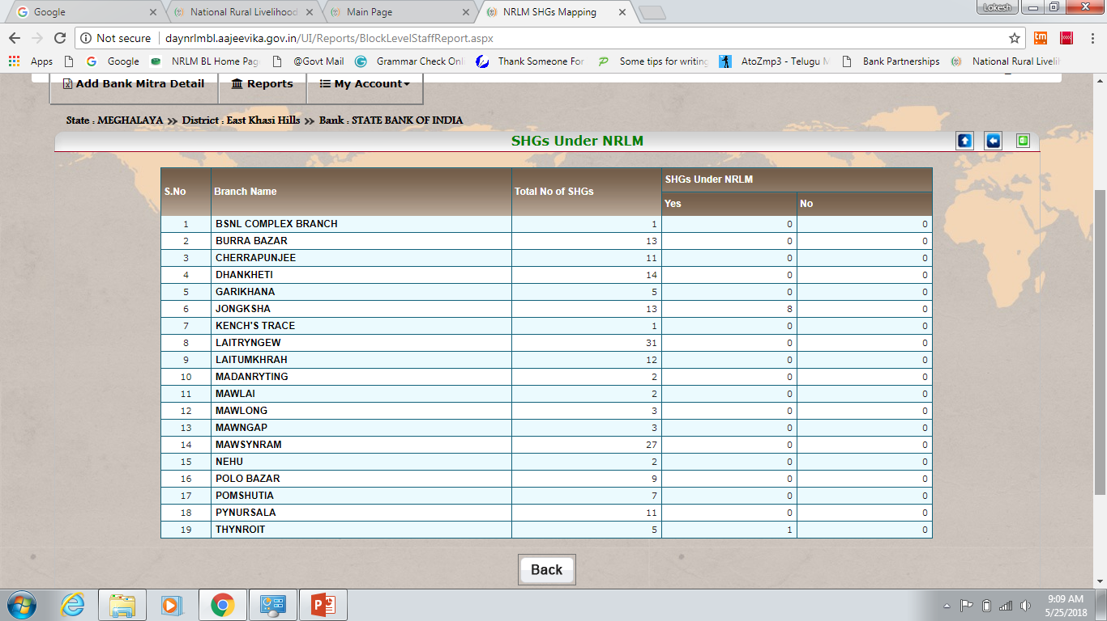

Slide 38
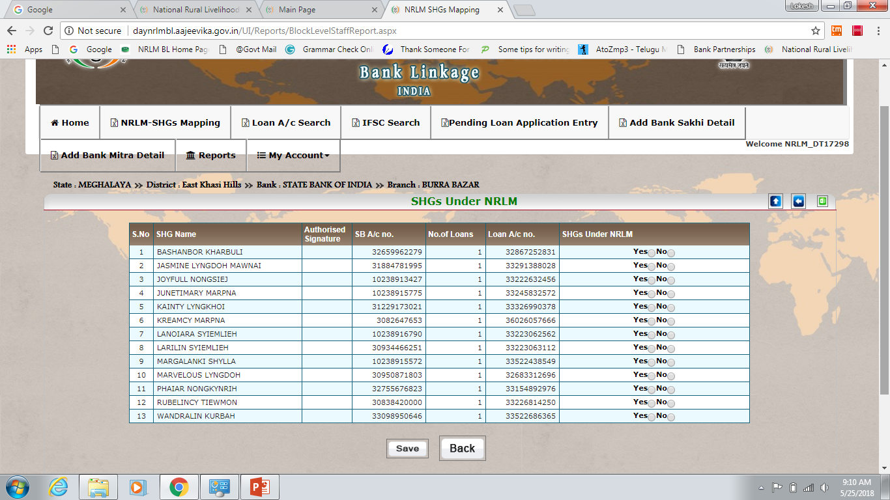

Slide 39
Thank you

